Slide 1



Flight Delay Analysis
Project 1 - KU Data Analytics Bootcamp
Presented by:
Peiwen Chiu
Jen Zapata
Heidi Fox

Slide 2
01
Project Selection / Background
What
Why
How
CONTENTS
02
Analyzed
On-Time Performance
Delay Patterns
Airport and Route Impact
03
On-Time Performance
04
Delay Patterns
05
Airport and Route Impacted

Slide 3
What – Why - How
This team chose to analyze flight delays over the past 5
years (May 2019 – May 2024). We narrowed our data to include only four of the main domestic airlines: American,
Delta, United, and Southwest. We examine the delay reason by using the five categories provided in the dataset
obtained by U.S. Bureau of Transportation Statistics (BTS); carrier delay, weather delay, aviation delay, security delay, or late aircraft.
This topic was selected because each of us on the team travel frequently for work and pleasure. The idea of digging into the data about delays intrigued us since we have experienced the disruption of it often.
We collected the dataset from U.S. Bureau of Transportation Statistics (BTS) as a csv file. We wrote and executed
Python script in Jupyter Notebook to explore the data.
We included Matplotlib and various libraries for data
visualization.
Flight delay categories:
Carrier Delay (carrier_ct): Delays caused by the airline itself, such as issues with crew, maintenance, or aircraft cleaning.
Weather Delay (weather_ct): Delays caused by weather conditions that make flying unsafe or impossible.
National Aviation System Delay (nas_ct): Delays related to air traffic control, airport operations, heavy traffic volume, or other reasons that
are part of the national aviation system.
Security Delay (security_ct): Delays caused by security-related issues such as security breaches or heightened security measures.
Late Aircraft Delay (late_aircraft_ct): Delays caused by a previous flight arriving late (can be combination of reasons), which impacts the
departure of the subsequent flight.

Slide 4




Top 3 Questions to Answer
On-Time Performance: What percentage of flights that are on time for each airline?
Comparison of Delay Causes and Number of Delayed Flights by Airline: How do the causes of delays and the number of delayed flights differ across each airline?
Airport and Route Impact: Are delays linked to specific airports or hubs?
https://1000logos.net

Slide 5
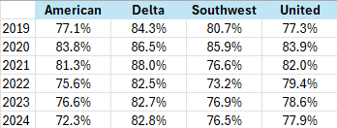
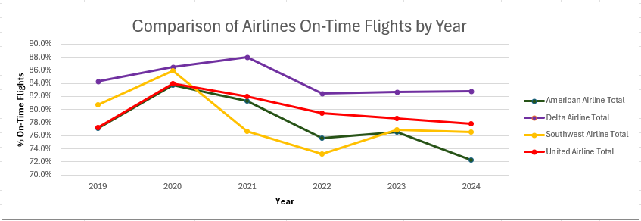
On-Time Flights
According to the International Air Transport Association (IATA),
on-time performance (OTP) is a critical indicator of an airline’s
reliability and is typically defined as the percentage of flights that
arrive and depart within 15 minutes of their scheduled time.
The data collected and analyzed for on-time flights showed an increased during 2020 and into 2021
This is the result of a reduction in flights during COVID. A reduction in flights will minimize airport traffic making it speedier to get through security as well as the boarding process at the gate. It will also reduce the amount of air traffic which allows for on-time flights.

Slide 6
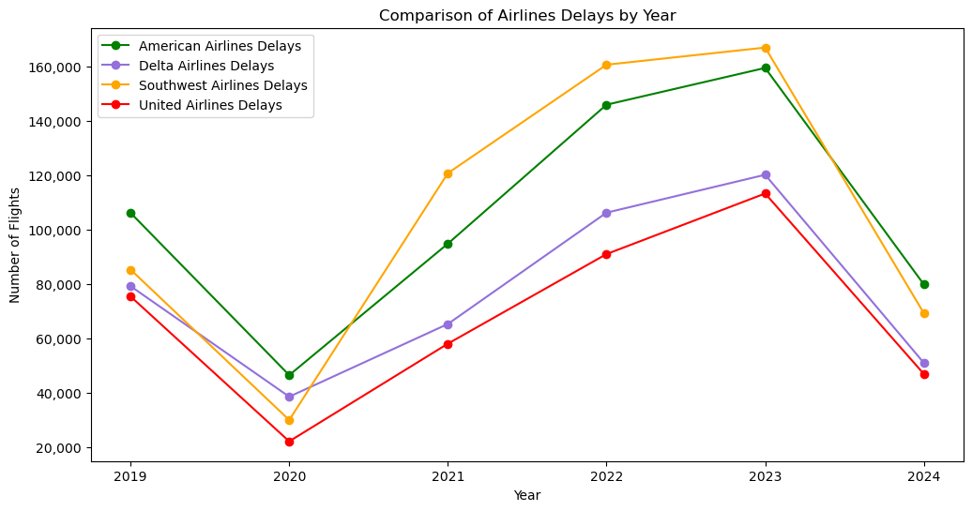
Delay Patterns
There is a noticeable dip in the number of delays across all airlines in 2020, likely due to the global impact of the COVID-19 pandemic, which significantly reduced flight operations. After 2020, a general upward trend is observed for all airlines, indicating a recovery in flight operations and possibly an increase in flight delays as air travel resumed to more typical levels. The number of delays appears to peak around 2022 or 2023.

Slide 7
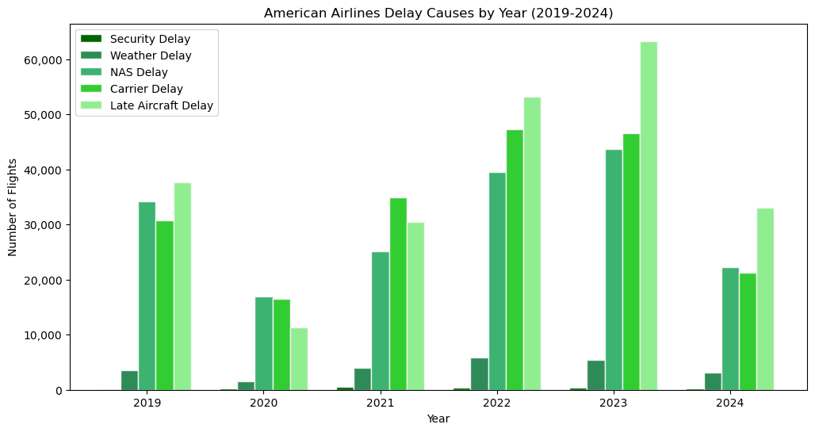
Delay Patterns
There is a significant reduction in delays across all categories in 2020, due to decreased flight operations due to the COVID-19 pandemic.
2021-2023 Delays increase steadily across most categories, indicating a recovery in flight operations.
Delays peak in 2023 before a decline in 2024.

Slide 8
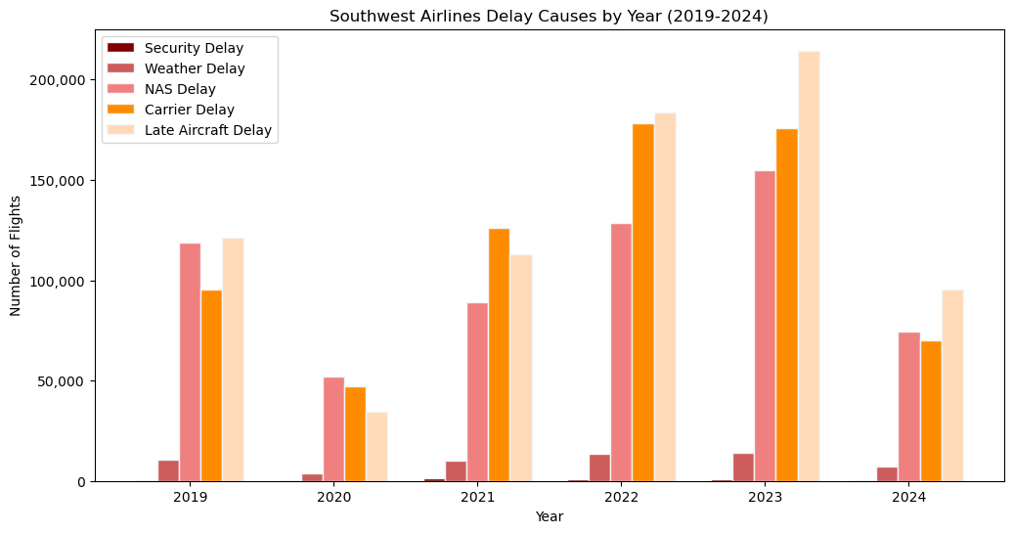
Delay Patterns
There is a significant reduction in delays across all categories in 2020
An increase in the number of delays, peaking in 2022 for most categories and remaining high in 2023.

Slide 9
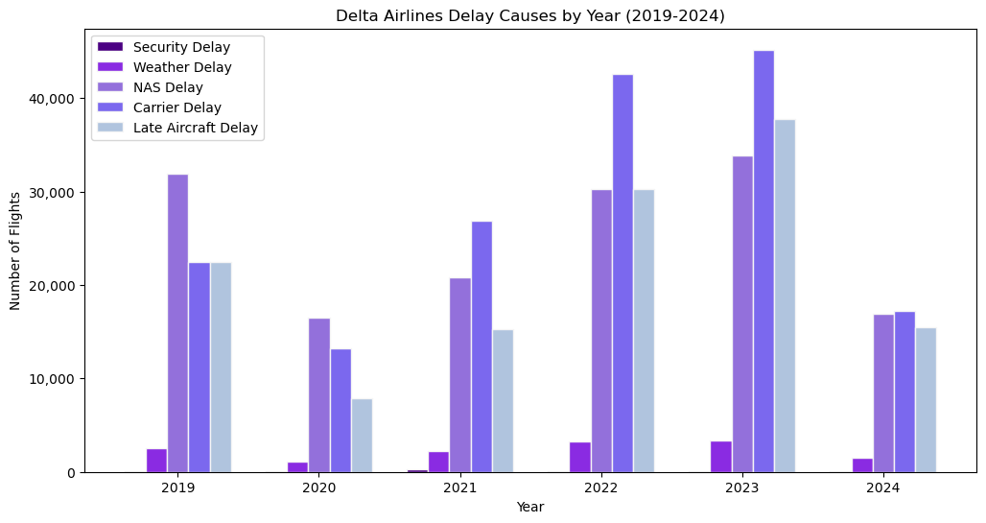
Delay Patterns
There is a significant reduction in delays across all categories in 2020
An increase in the number of delays, peaking in 2022 for most categories and remaining high in 2023.

Slide 10
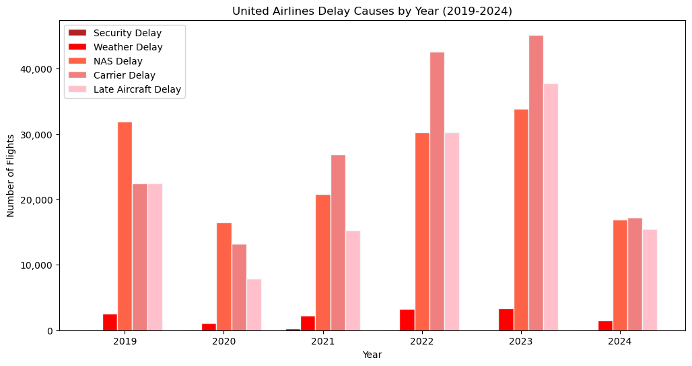
Delay Patterns
There is a significant reduction in delays across all categories in 2020
An increase in the number of delays, peaking in 2022 for most categories and remaining high in 2023.

Slide 11
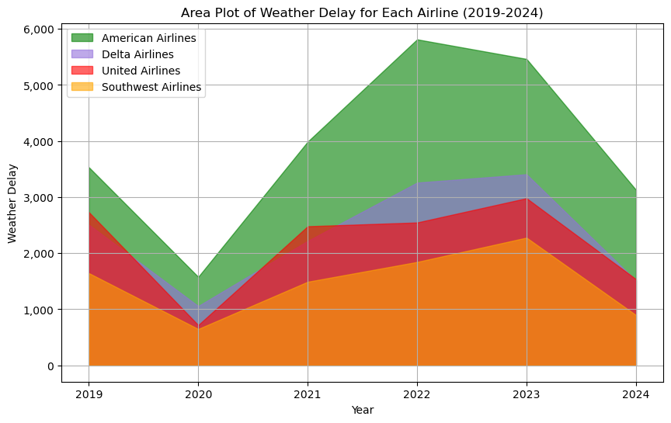
Delay Patterns
There is a significant reduction in delays across all categories in 2020
An increase in the number of delays, peaking in 2022 for most categories and remaining high in 2023.

Slide 12
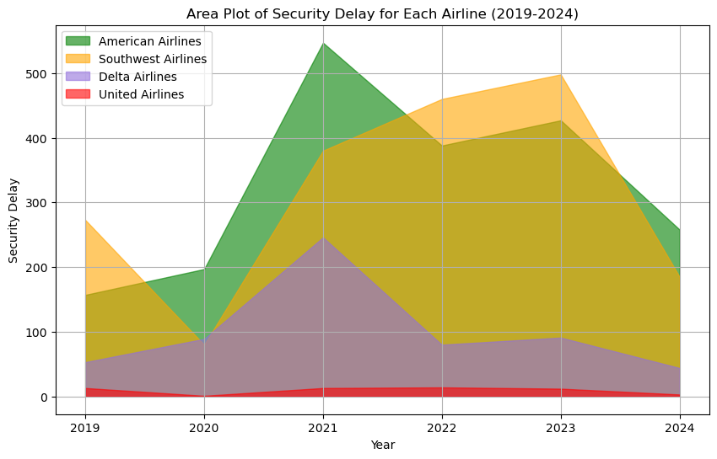
Delay Patterns
There is a significant reduction in delays across all categories in 2020
An increase in the number of delays, peaking in 2022 for most categories and remaining high in 2023.

Slide 13
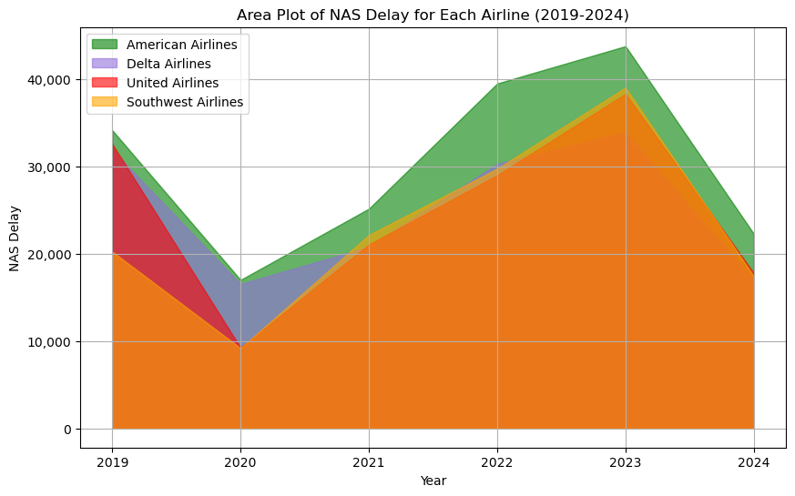
Delay Patterns
There is a significant reduction in delays across all categories in 2020
An increase in the number of delays, peaking in 2022 for most categories and remaining high in 2023.

Slide 14
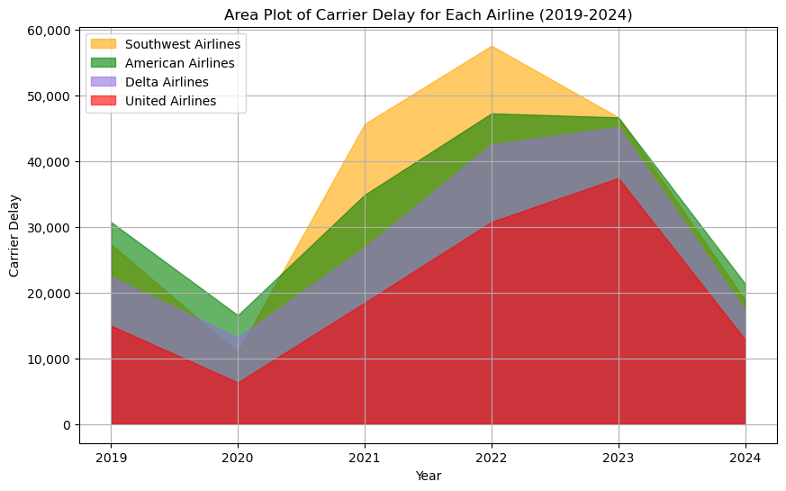
Delay Patterns
There is a significant reduction in delays across all categories in 2020
An increase in the number of delays, peaking in 2022 for most categories and remaining high in 2023.

Slide 15
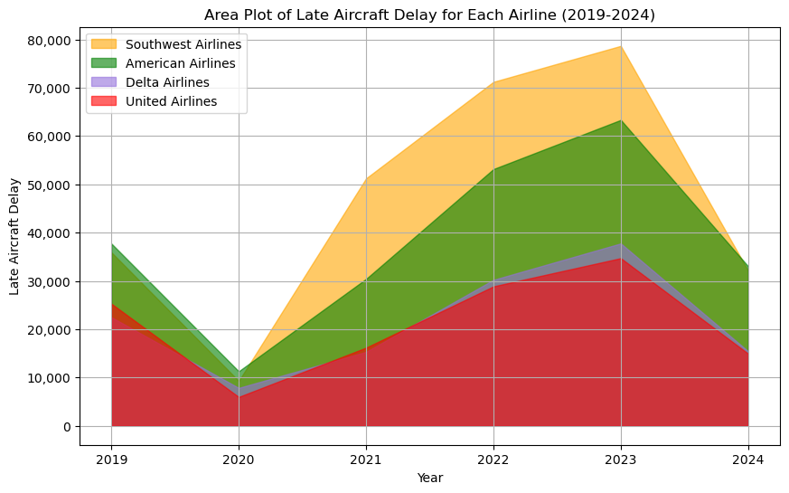
Delay Patterns
There is a significant reduction in delays across all categories in 2020
An increase in the number of delays, peaking in 2022 for most categories and remaining high in 2023.

Slide 16
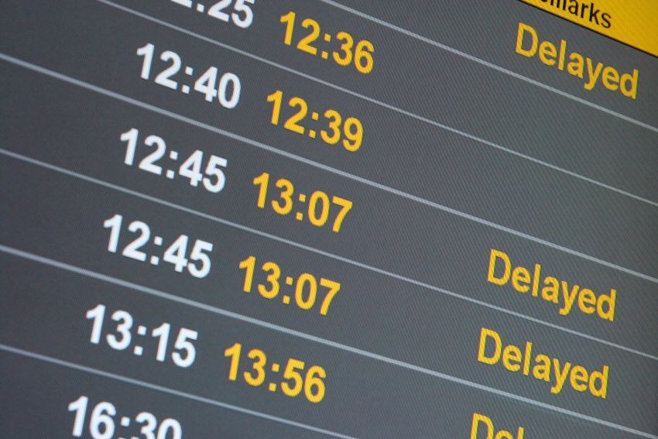
Delay Patterns - Conclusion
Southwest Airlines generally experiences higher delays across most categories, especially in carrier and late aircraft delays, which indicating significant operational challenges.
American Airlines shows a broad range of delays, especially in weather and security categories, pointing to specific areas needing improvement in their operation procedures.
Delta Airlines and United Airlines generally perform better with lower delays across most categories, suggesting effective operations and management.
https://www.businesstravelnewseurope.com/Air-Travel/IATA-hits-out-at-US-airline-delay-compensation-plan

Slide 17
Airports & Routes Impacted
Replace with your own text

Slide 18
Do you have any questions?
THANK YOU!

